Slide 1
Activity-Based Costing: A Tool to Aid Decision Making
Chapter 7
As edited substantially by Prof. Duquette 3-21-23 to show cross-referencing of data being used

Slide 2
LO 1--How Costs are Treated Under Activity–Based Costing
Manufacturing costs
Nonmanufacturing costs
All
Most, but not all
Some
Traditional product costing
ABC product costing
ABC systems can assign sales commissions, shipping costs, and warranty repair costs to specific products or customers.
ABC excludes organization-sustaining costs and idle capacity costs from product cost.

Slide 3
LO 1--Step 1: Identify Baxter Battery Key Activities
Unit-Level Activity
e.g. Direct materials, direct labor; utilities for specific machines;
machine supplies; equipment depreciation; machine maintenance-
These tend to increase the more units you produce.
Batch-Level Activity
e.g. Purchase ordering; machine set ups; quality control; organizing shipments;
These tend to be constant regardless how many units you produce
Manufacturing companies typically combine their activities into five classifications
to help determine if they are ABC type costs.
Product-Level Activity
e.g. Design changes; assembly line changes;
warehousing manager and storage costs; advertising; product line and brand managers
These tend to be constant regardless how many units or batches you produce
Customer-Level Activity
e.g. Sales calls; catalog mailings; post sale tech support;
These will be assigned to a segment margin report on the customer, not to the product.
Organization Sustaining Activity
e.g.,, ie. Plant management and support staff salaries; cleaning, IT network, financing, audits, unused capacity costs, factory depreciation or rent, factory utilities
Incurred regardless of number of units, or batches, or which products are produced, or customers

Slide 4
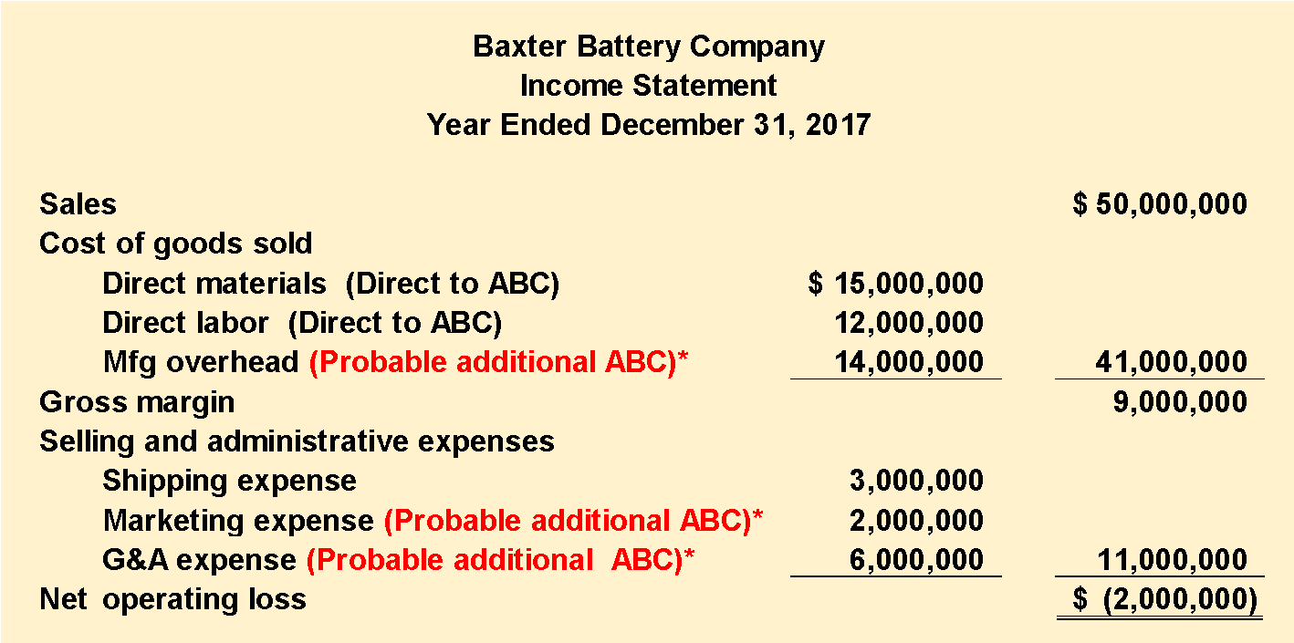
LO 1--The Five Steps for Implementing ABC Here is Baxter Battery’s Condensed Income Statement
The company makes two types of automobile batteries—SureStart (a standard battery) and LongLife (a deluxe battery). Baxter reported its first loss ever. Total costs = CGS + S&A= $52,000,000
*Probable additional ABC costs = $22,000,000—see slide 5 for the details given by the author

Slide 5
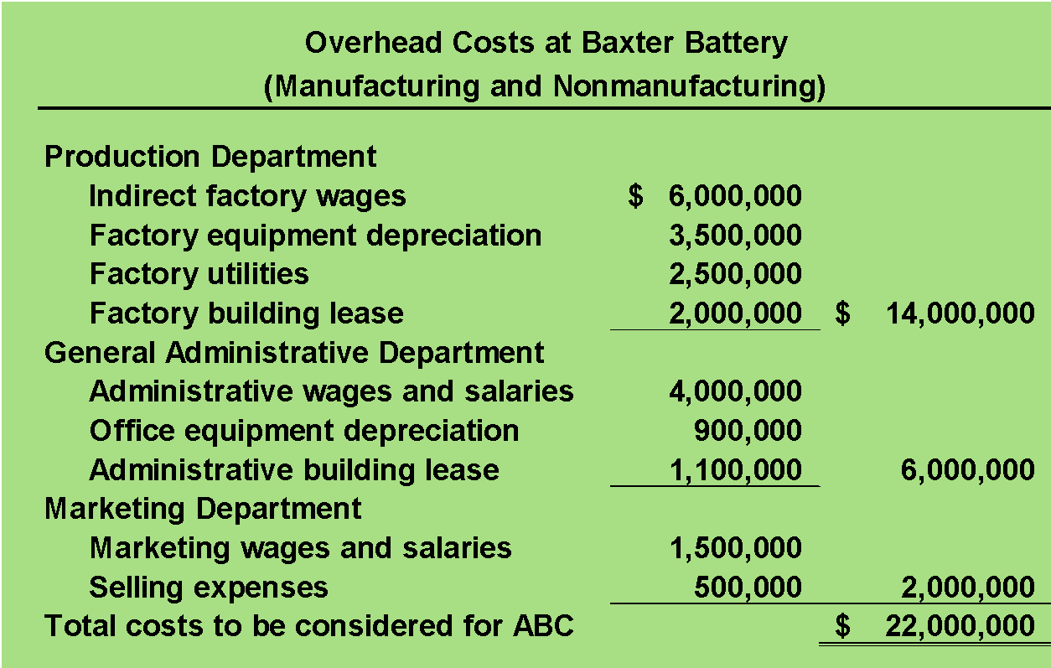
LO 2--Step 2: “First Stage”--Assign ABC Costs to Activity Cost Pools Given: Detail of Probable Additional ABC Costs Below to Be Considered for ABC Costing to Products and Customers
Direct materials, direct labor, and shipping are excluded because Baxter Battery’s existing cost system can directly trace these costs to products or customer orders.
= Total slide 3 potential additional ABC costs

Slide 6
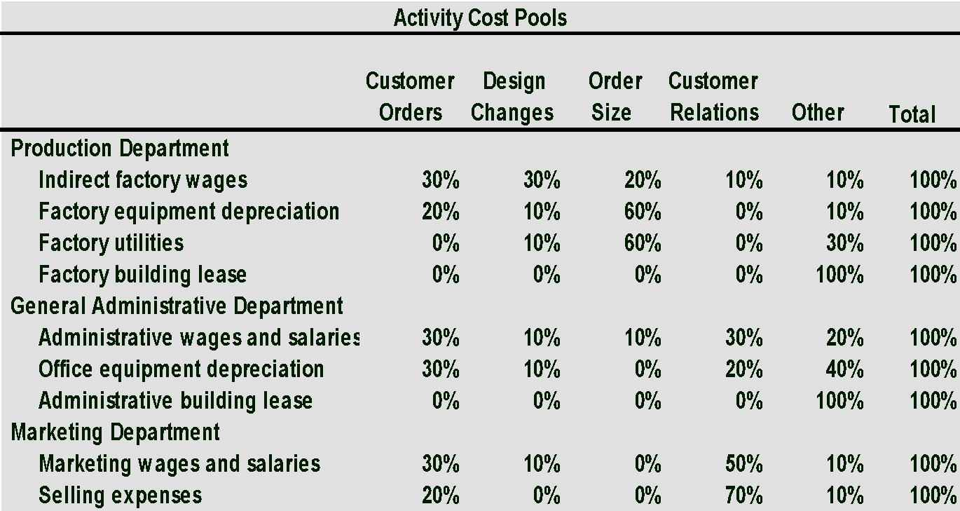
LO 2--Step 2: “First Stage”-- Cont’d: Assign Probable Additional ABC Costs to Activity Cost Pools
GIVEN: At Baxter Battery, the following distribution of resource consumption across activity cost pools is determined after careful time motion, personnel, and engineering studies.

Slide 7
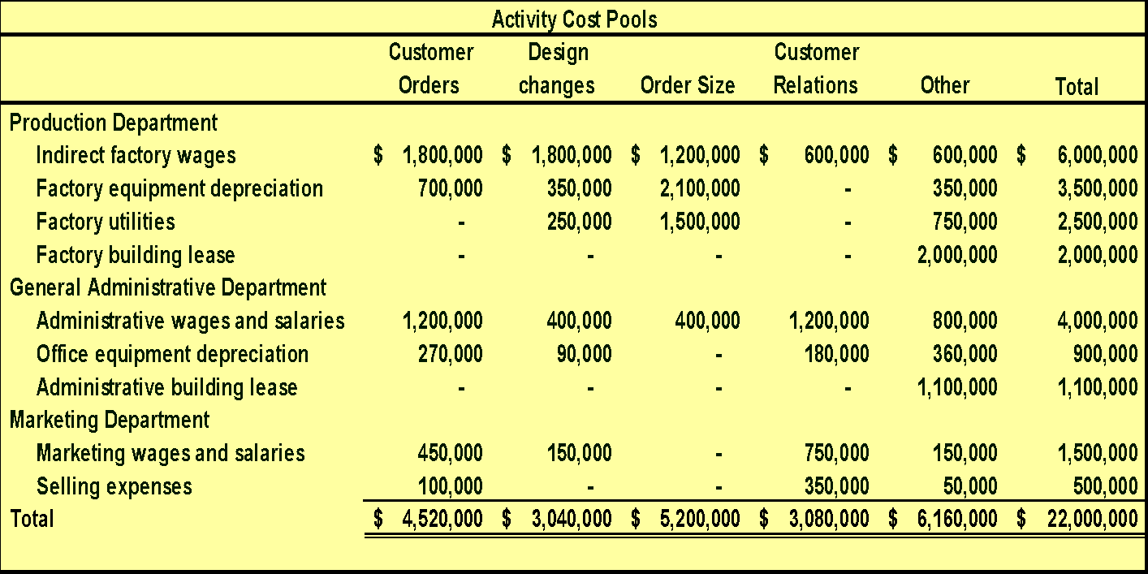
LO 2--Step 2: “First Stage”--(Cont’d): Assign Probable Additional ABC Costs to Activity Cost Pools (Multiply Costs on Slide 5 by Data on Sl 6)
“Customer Relations” and “Other” will not be assigned to products, but “customer relations” may be assigned to customer margin reports later. “Other” will be classified as organization sustaining costs and not allocated anywhere. Total of both = $9,240,000

Slide 8
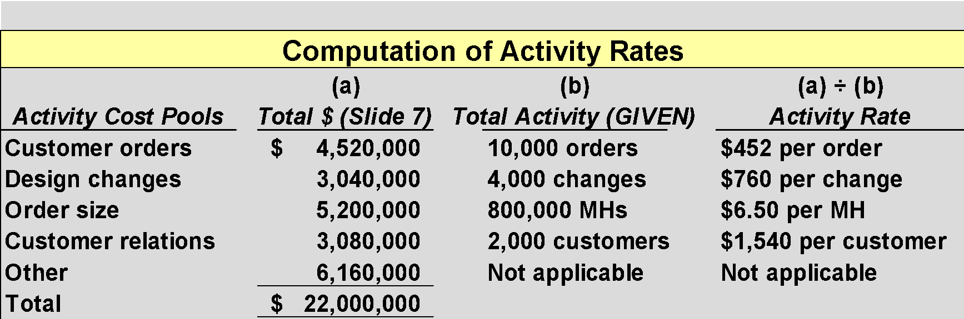
LO 3--Step 3: Calculate Activity Rates
These last two will not be assigned to products but “customer relations” may be assigned to customer margin reports later, and “Other” will be classified as organization sustaining and not allocated anywhere. Total of both = $9,240,000 per slide 7.

Slide 9
LO 4--Step 4: “Second stage allocation”—Assigning ABC Costs to Products With Activity Data per Product
Baxter Battery Information
SureStart
Requires no new design resources.
800,000 batteries ordered with 4,000 separate orders.
Each SureStart requires 36 minutes of machine time for a total of 480,000 machine-hours.
LongLife
Requires new design resources.
400,000 batteries ordered with 6,000 separate orders.
4,000 custom designs prepared.
Each LongLife requires 48 minutes of machine time for a total of 320,000 machine-hours.

Slide 10
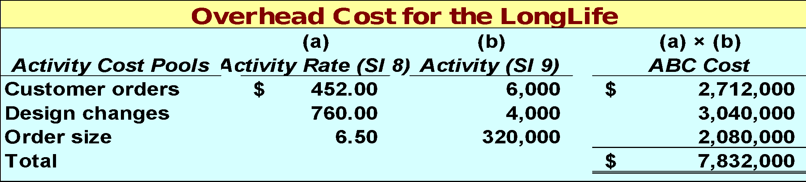
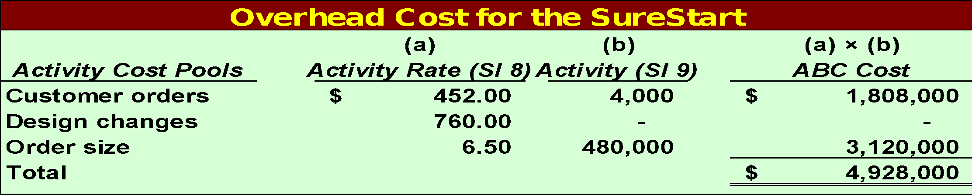
LO 4--Step 4 (Cont’d) Second Stage Allocation--Assigning ABC Costs to Products
Surestart: $4,928,000 + LongLife: $7,832,000 = $12,760,000
+ $9,240,000 (per slide 7 not assigned to product costs) =
$22,000,000 (= total potential ABC costs to be considered slide 5 )

Slide 11
LO 5--Step 5: Calculate Product Margin Using ABC Costs That Were Assigned to Each Product
Total costs above = $42,760,000 allocated to both products, + costs not allocated to products per slide 7 of $9,240,000 = Sum of CGS $41,000,000 + S&A $11,000,000 on slide 3 = $52,000,000.

Slide 12
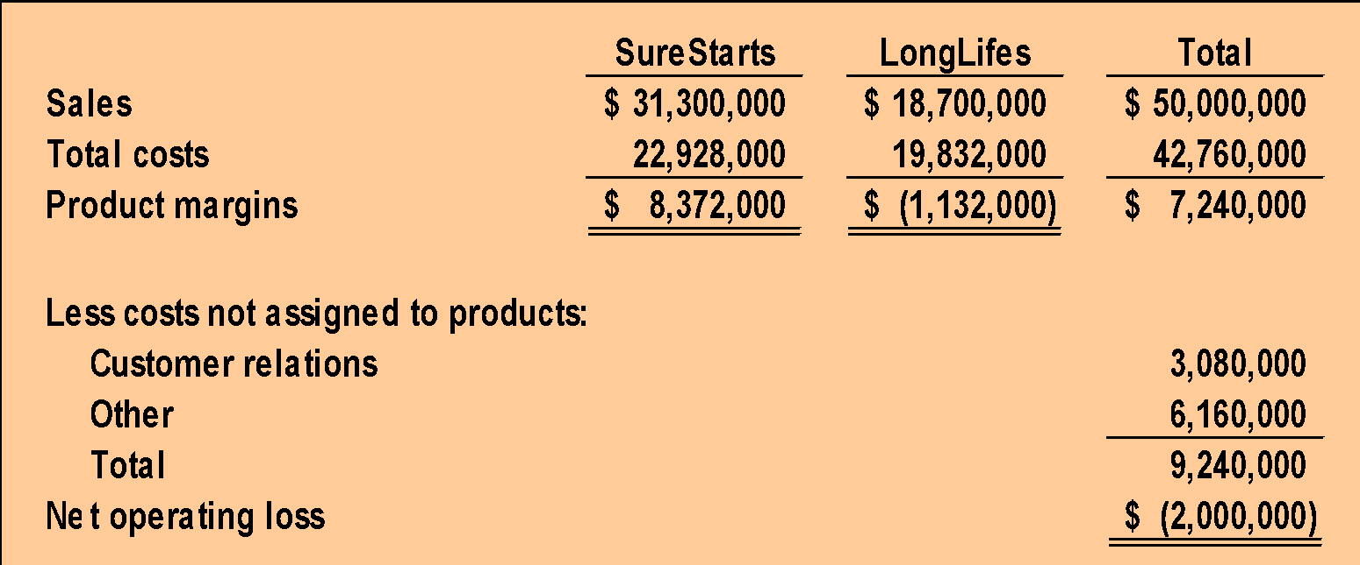
The product margins can be reconciled with the company’s net operating income as follows
Per slide 11
(Per slide 7)
(Per slide 4)

Slide 13
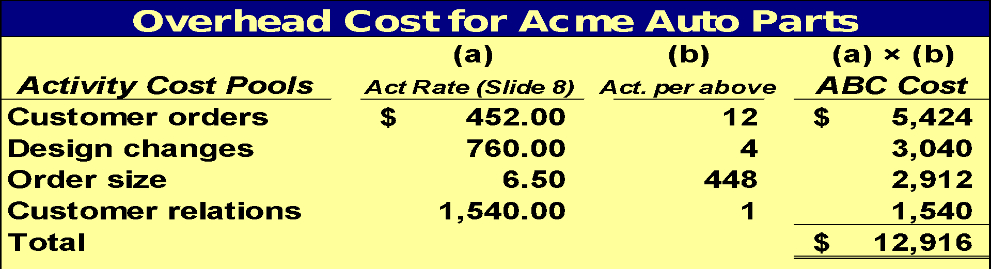
LO 5--Assigning Relevant ABC Costs to Customer Acme : Assign ABC Overhead and Customer Relations Costs
Orders from Acme
Eight orders for 60 SureStarts per order.
Four orders for 50 LongLifes per order (all 4 required a design change).
Machine-hours
The 480 SureStarts required 288 machine-hours.
The 200 LongLifes required 160 machine hours
Total 448 machine hours were needed.

Slide 14
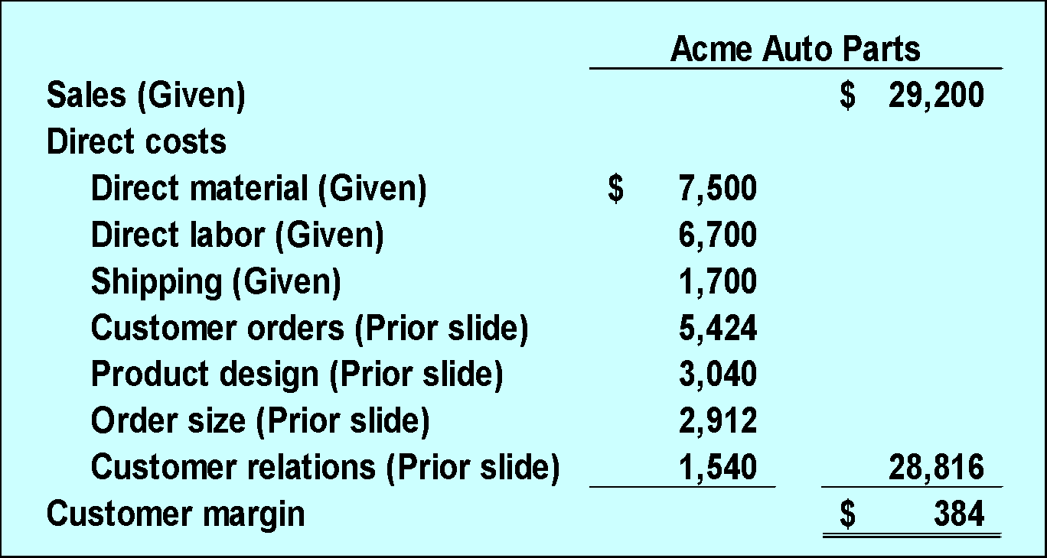
LO 5--Customer Margin Calculation –Acme

Slide 15
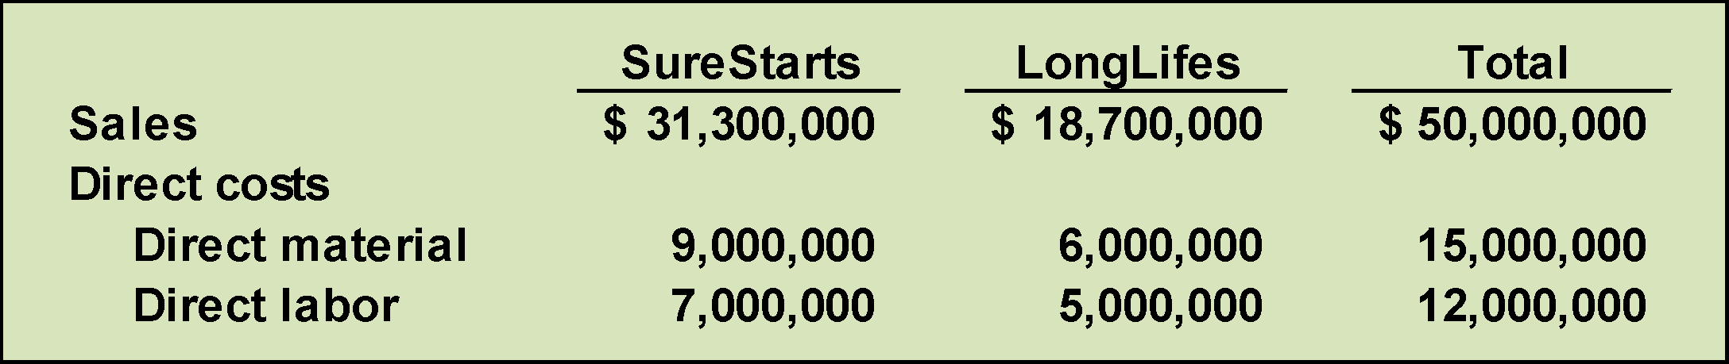
Summary: Compare ABC to Traditional Cost System Part 1
The first step in computing traditional absorption
costs product margins is to gather each product’s sales and direct cost data: See Slide 11 .

Slide 16
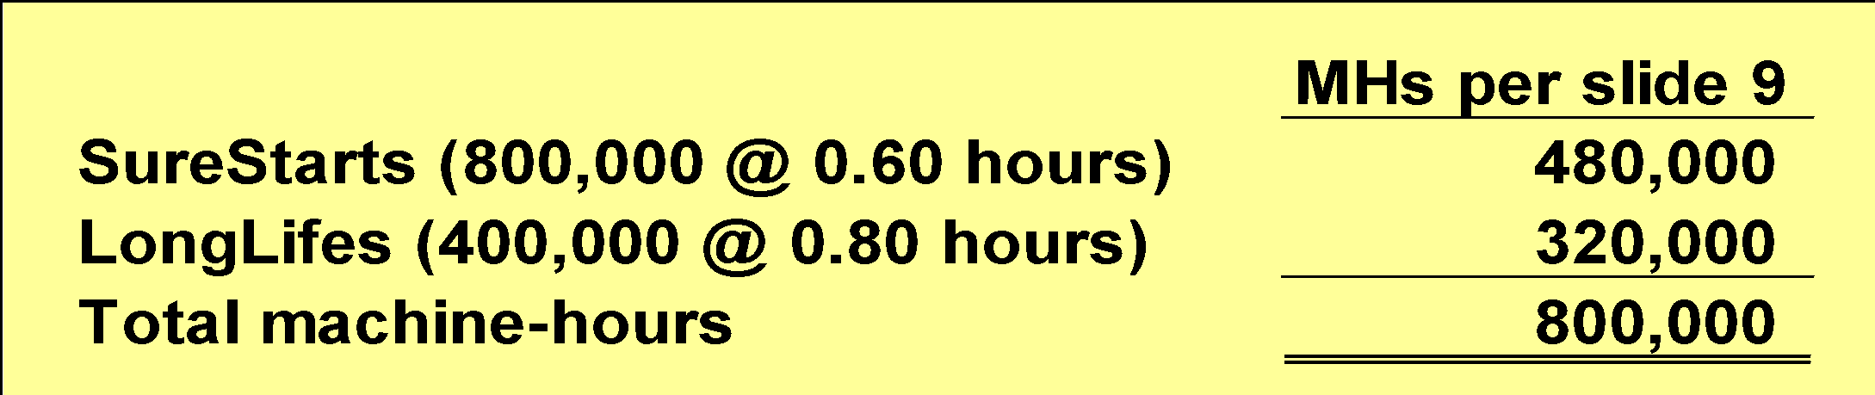
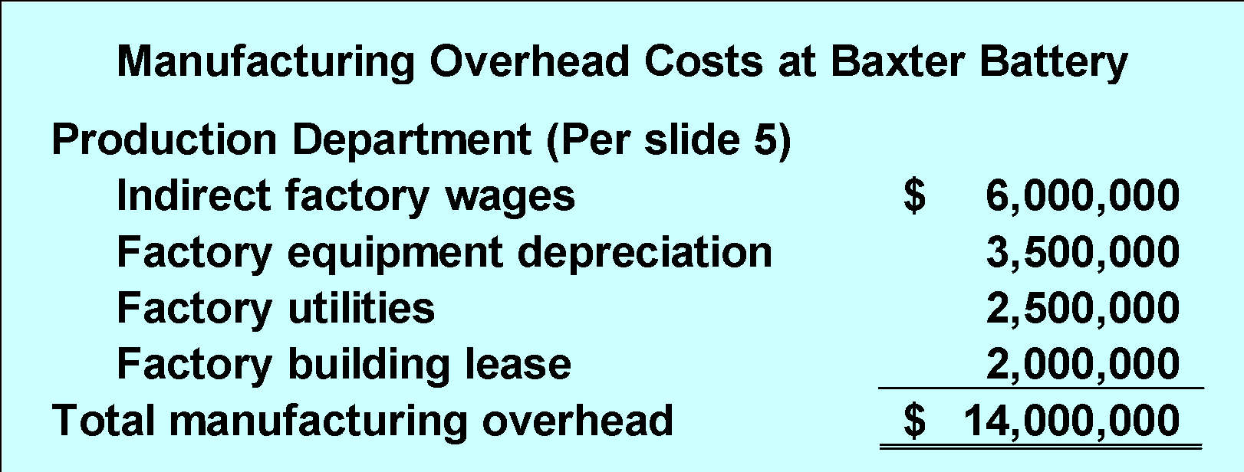
Compare ABC to Traditional Cost System: Part 2
The second step in computing traditional cost product margins is to compute the plantwide overhead rate (per chapter 2) .
Plantwide manufacturing
overhead rate
=
$14,000,000
800,000 MH
= $17.50 per machine-hour

Slide 17
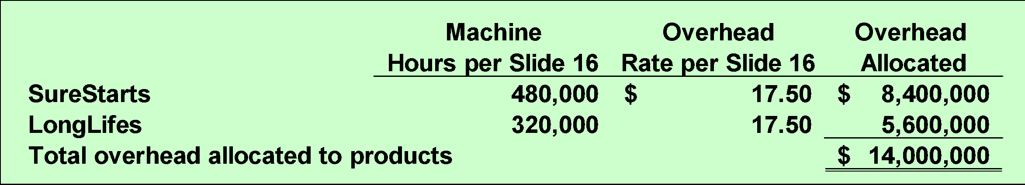
Compare ABC to Traditional Cost System: Part 3
The third step in computing product margins under
absorption costing is to allocate manufacturing
overhead to each product.

Slide 18
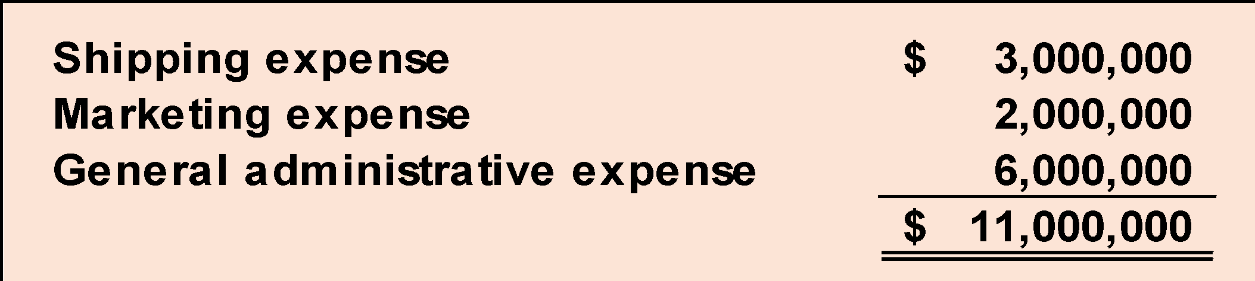
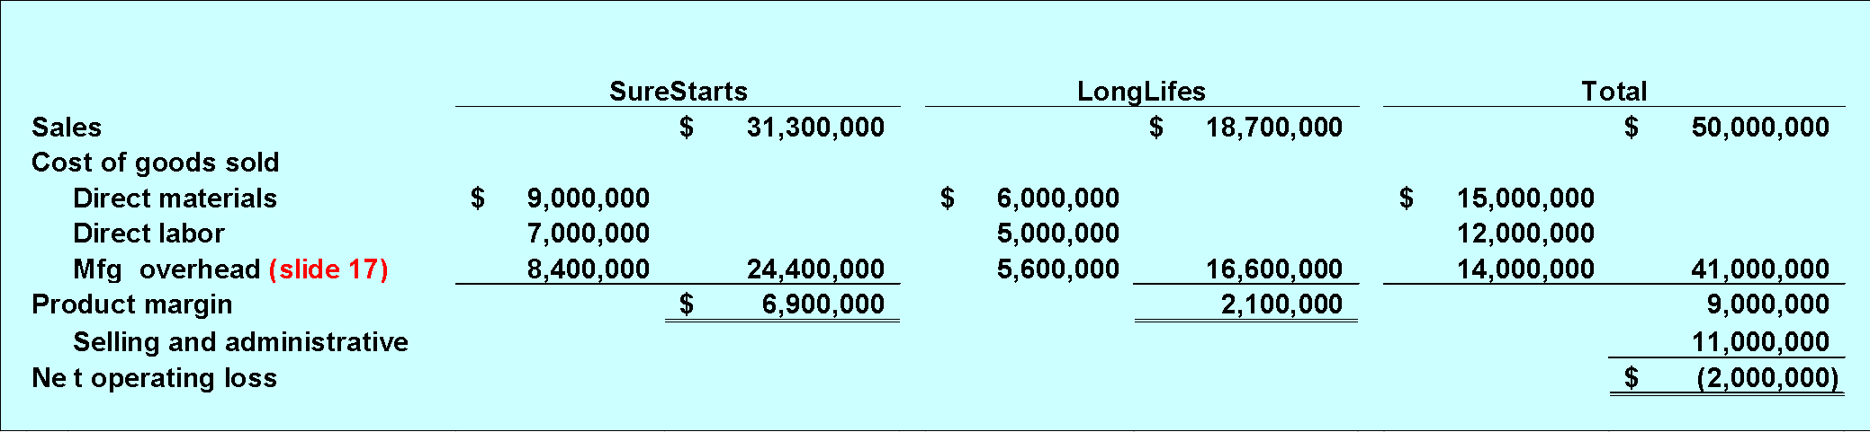
Compare ABC to Traditional Cost System: Part 4
The fourth and final step is to actually compute the product margins under absorption costing.
Most info from slide 15
Totals as per Slide 3
from slide 3
Notes:
Most info from slide 15

Slide 19
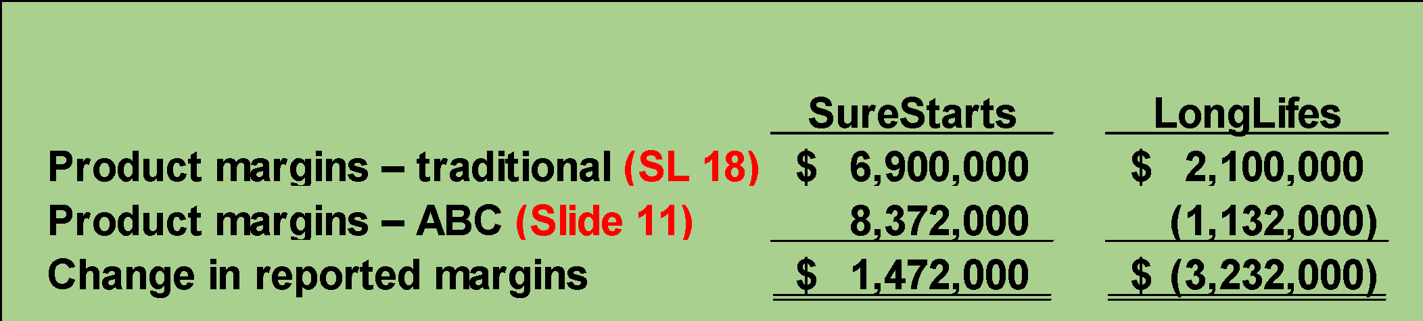
Differences Between ABC and Traditional Absorption Cost Approach to Product Cost
The traditional cost system overcosts the SureStarts and reports a lower product margin for this product.
The traditional cost system undercosts the LongLifes and reports a higher product margin for this product.

Slide 20
Poll 1
An activity-based costing system that is designed for internal decision-making will not conform to generally accepted accounting principles because:
A. under activity-based costing some manufacturing costs (i.e., the costs of partially idle capacity and organization-sustaining costs) will not be assigned to products
B. under activity-based costing the sum of all product costs does not equal the total costs of the company
C. activity-based costing has not been approved by the United Nation’s International Accounting Board
D. activity-based costing always results in less accurate costs than more traditional costing methods based on direct labor-hours or machine-hours

Slide 21
Poll 2
In activity-based costing, the activity rate for an activity cost pool is computed by dividing the total overhead cost in the activity cost pool by:
A. the direct labor-hours required by the product
B. the machine-hours required by the product
C. the total activity metric for the activity cost pool
D. the total direct labor-hours for the activity cost pool

Slide 22
Poll 3
An activity rate of $512 per product design means that on average any one particular product design consumes resources that cost $512.
A. True
B. False

Slide 23
Poll 4
In the “second-stage allocation” in activity-based costing, activity rates are used to apply overhead costs to products and customers.
A. True
B. False

Slide 24
Poll 5
To compute a product’s profit or product margin, the product’s sales and direct costs are needed in addition to the overhead costs computed in an activity-based costing system.
A. True
B. False

